Slide 1




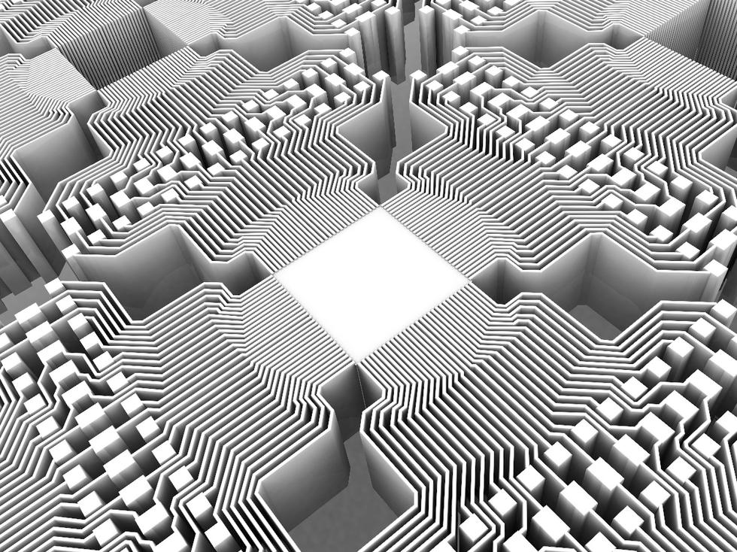

Slide 2

QuantumMining

Slide 3


Slide 4
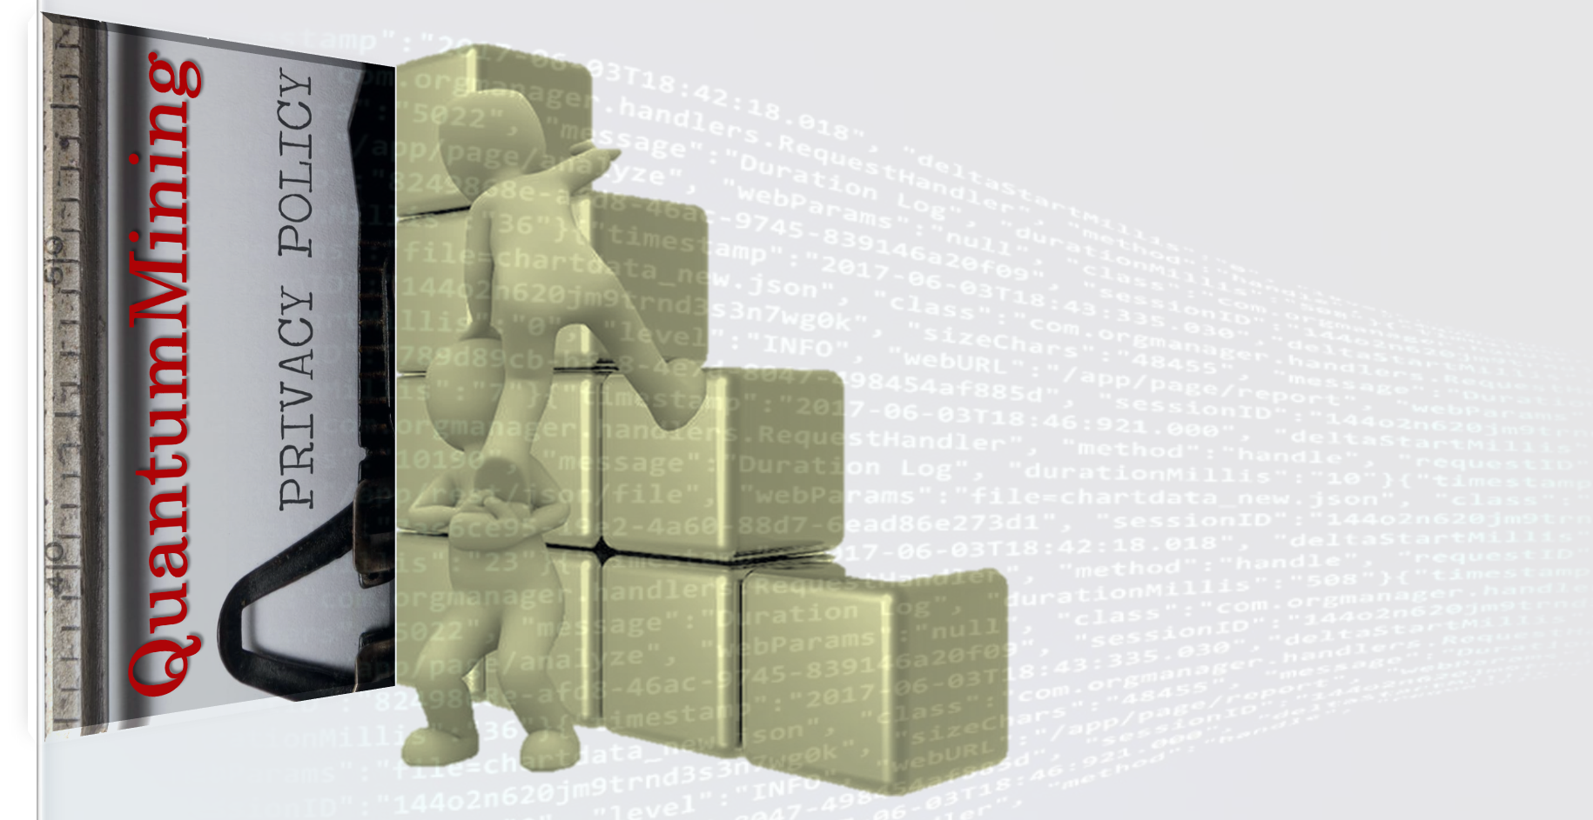

Slide 5


Slide 6
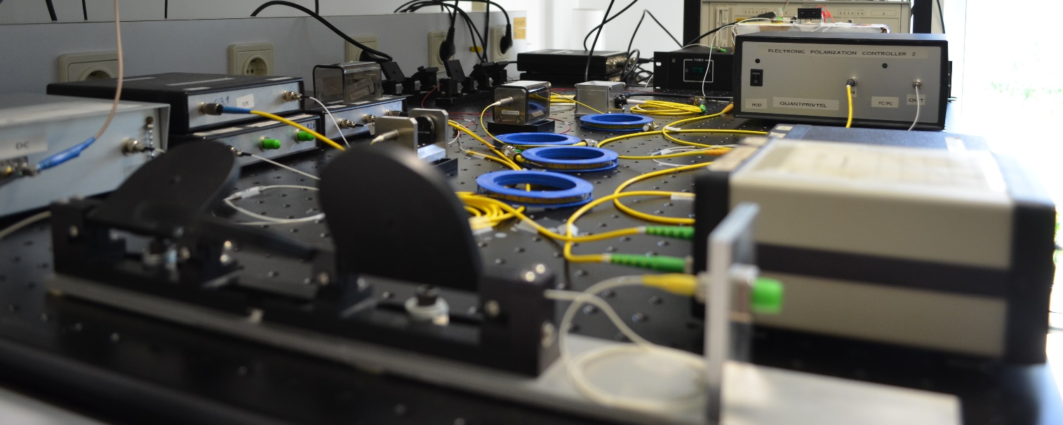

Slide 7
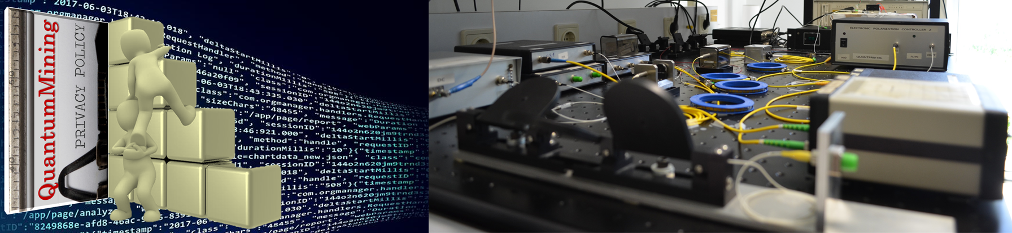


Slide 8
Private Data Mining
Private Data Mining
Quantum Oblivious Transfer

